Slide 1
Harmonic Mean

Slide 2
What is Harmonic Mean?
It is a measure of central tendency.
Used to express the average rate of n observations.
Eg:
production volume per day
Kilometre per litre of fuel
Distance travelled by hour

Slide 3
Definition
Harmonic mean is used to calculate the average of a set of numbers.
The harmonic mean is the reciprocal of the average of the reciprocals of the individual observations.
It is calculated by dividing the number of observations by the sum of reciprocal of the observation.

Slide 4
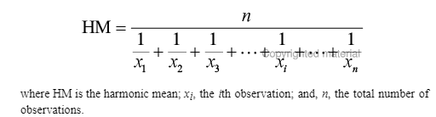

Harmonic Mean For ungrouped data
The formula to find the harmonic mean is given by:
For Ungrouped Data:
x₁, x₂, x₃, …. x_{n} = Individual terms or individual values.
or HM = $\frac{n}{\sum_{i=1}^{n}{\frac{1}{xi}}}$

Slide 5
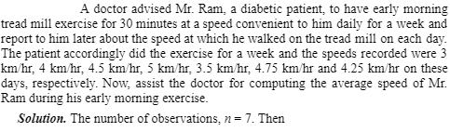
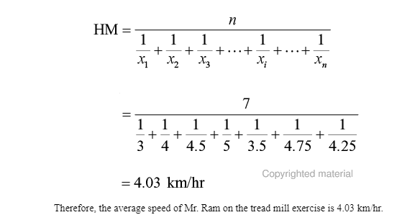
Solve:

Slide 6

Harmonic Mean For grouped data – Discrete Series
HM = $\frac{f1+f2+f3+ . . . . . . . . . . . .+fn}{\frac{f1}{x1} + \frac{f2}{x2 }+ \frac{f3 }{x3} + . . . . . . . . . …. +\frac{fn}{xn}}$
= $\frac{\sum_{i=1}^{n}{fi}}{\sum_{i=1}^{n}{\frac{fi}{xi}}}$

Slide 7
Solve: The table given below represent the frequency-distribution of ages for Standard 1 students. Find the Harmonic Mean of the given class.
Ages | 4 | 5 | 6 | 7
Number of Students | 6 | 4 | 10 | 8

Slide 8
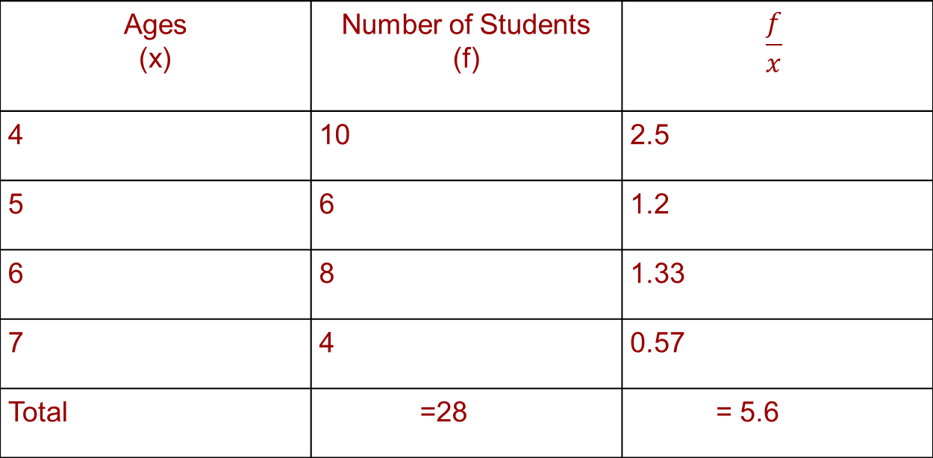
So Harmonic mean = = 5 years Therefore, Harmonic mean(H) = 5 years
Ages (x) | Number of Students (f) | $$\frac{f}{x}$$
4 | 10 | 2.5
5 | 6 | 1.2
6 | 8 | 1.33
7 | 4 | 0.57
Total | =28 | = 5.6

Slide 9
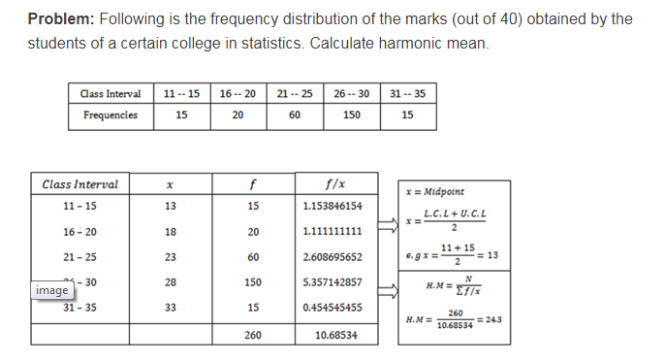
Harmonic Mean For grouped data – Continuous Series

